Slide 1

CPPUnit
By: Tuan Nguyen Manh
Course duration: 3 hours
Last update: Dec 2008

Slide 2

Content
Overview
Features
Build CppUnit Libraries
Setup environment for VC6
Base Classes
Create CppUnit's MFCTestRunner
Build UnitTest for existing MFC project
Outputter

Slide 3
Content by Staff Level
For 1-year engineer (junior engineer)
Overview
Features
Build CppUnit Libraries
Setup environment for VC6
Create CppUnit's MFCTestRunner
For 3-year engineer (lead engineer)
Build CppUnit Libraries
Setup environment for VC6
Base Classes
Create CppUnit's MFCTestRunner
Build UnitTest for existing MFC project
Outputter
For 4-year or higher engineer (senior engineer)
Build UnitTest for existing MFC project
Outputter

Slide 4
Overview
A C++ testing framework
C++ port of the famous JUnit framework for unit testing
Open-source product
Can be used stand-alone or with an IDE
Available from http://sourceforge.net/projects/cppunit

Slide 5
Features
XML output with hooks for additional data
Compiler-like text output to integrate with an IDE
Helper macros for easier test suite declaration
Hierarchical test fixture support
Test registry to reduce recompilation need
Test plug-in for faster compile/test cycle (self testable dynamic library)
Protector to encapsulate test execution (allow capture of exception not derived from std::exception)
MfcTestRunner
QT based graphic test runner

Slide 6
Build CppUnit Libraries
Step 1:
Go to site http://sourceforge.net/projects/cppunit/ to download CPPUnit
Unpack into folder $CPPUNIT
Step 2:
Open the $CPPUNIT/src/CppUnitLibraries.dsw workspace in VC++.
In the 'Build' menu, select 'Batch Build...'
In the batch build dialog, select all projects and press the build button.
The resulting libraries can be found in the $CPPUNIT/lib/ directory.

Slide 7
Setup environment for VC6
Changing the project-settings
Enable Run-Time Type Information (RTTI)
Select The Appropriate Run-Time Library to [Debug Multithreaded DLL]
Turn Off Precompiled Headers
Set The Preprocessor Include Path
Link To The Appropriate CppUnit/TestRunner Libraries
Change the visual studio options
Update Visual Studio's Include Path
Update Visual Studio's Library Path
Update Visual Studio's Source Path
Make Sure testrunnerd.dll Is In Your PATH

Slide 8
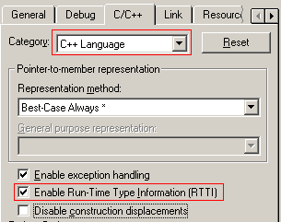
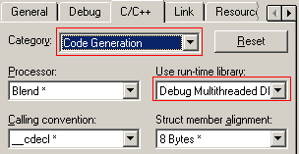

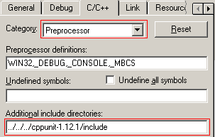
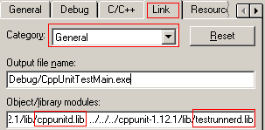
Changing the project-settings
Select The Appropriate Run-Time Library
Enable Run-Time Type Information (RTTI)
Turn Off Precompiled Headers
Set The Preprocessor Include Path
Link To The Appropriate CppUnit/TestRunner Libraries

Slide 9
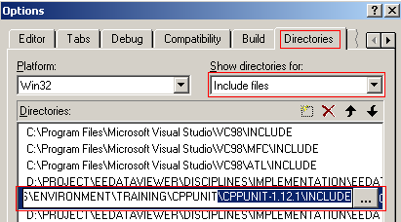
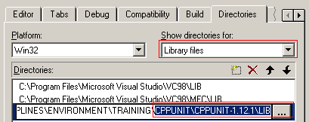
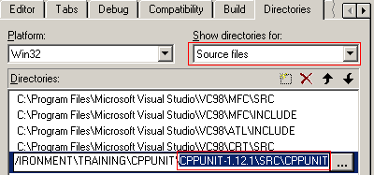
Change the visual studio options
Update Visual Studio's Library Path
Update Visual Studio's Include Path
Make Sure testrunnerd.dll Is In Your PATH
Copy testrunnerd.dll to [Debug] folder of your application
Copy testrunner.dll to [Release]
Update Visual Studio's Source Path

Slide 10
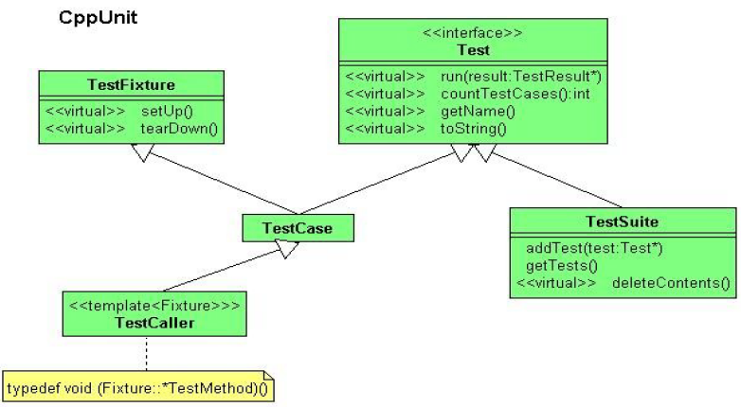
Base Classes

Slide 11
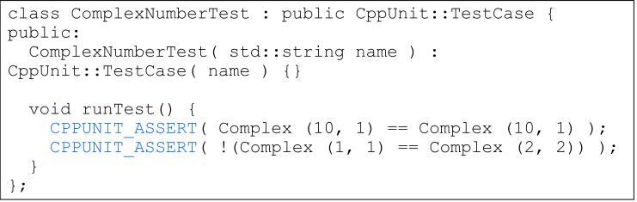
Simple Test Case
Ordinarily, you will not use such simple test
Subclass the TestCase class.
Override the method runTest().
When you want to check a value, call CPPUNIT_ASSERT(bool) and pass in an expression that is true if the test succeeds

Slide 12
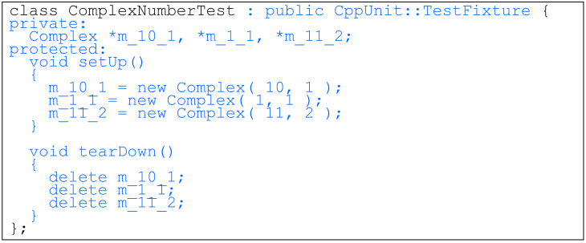
Fixture
A known set of objects served as a base for a set of test cases
To add new tests
Add member variables for each part of the fixture
Override setUp() to initialize the variables
Override tearDown() to release any resources allocated in setUp()

Slide 13
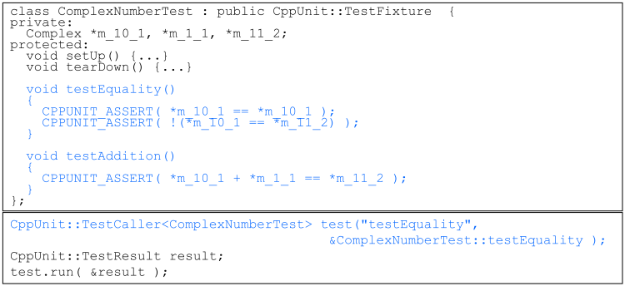
TestCaller
How do you write and invoke individual tests using a fixture?
Write the test case as a method in the fixture class
Create a TestCaller which runs that particular method

Slide 14
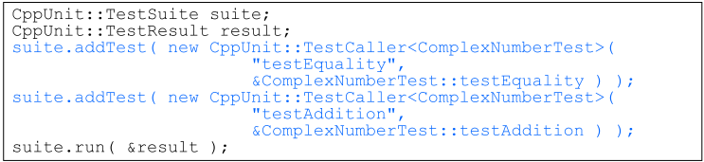
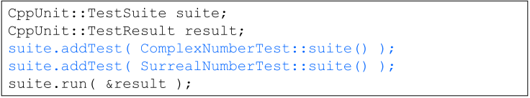
TestSuite
Use TestSuite class that runs any number of TestCases together
TestSuite can contain any object implementing the Test interface

Slide 15
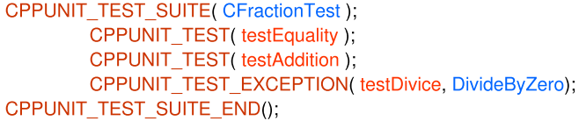
TestSuite
Other way to run TestCase more easily, use some macros:
CPPUNIT_TEST_SUITE: Begin test suite.
CPPUNIT_TEST: Add a method to the suite.
CPPUNIT_TEST_EXCEPTION: Add a test which fail if the
specified exception is not caught.
CPPUNIT_TEST_FAIL: Adds a test case which is excepted
to fail.
...
CPPUNIT_TEST_SUITE_END: End declaration of the test
suite.

Slide 16
Test cases Example
//Macros to Organize test cases and test suites here
void CFractionTest::setUp() {
m_f1 = new Fraction(3,4);
m_f2 = new Fraction(7,3);
m_f3 = new Fraction(37,12);
}
void CFractionTest::tearDown() {
delete m_f1;
delete m_f2;
delete m_f3;
}
void FractionTest::testAddition() {
CPPUNIT_ASSERT( *m_f1 + *m_f2 == *m_f3 );
}

Slide 17
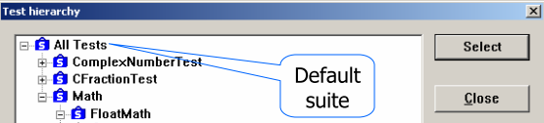
Organize test cases and test suites
CPPUNIT_TEST_SUITE_REGISTRATION(ATestFixtureType)
Adds the specified fixture suite to the default suite.
CPPUNIT_TEST_SUITE_NAMED_REGISTRATION(ATestFixtureType, suiteName)
Adds the specified fixture suite to the specified registry suite.
CPPUNIT_REGISTRY_ADD(which, to)
Adds the specified suite to other suite.
CPPUNIT_REGISTRY_ADD_TO_DEFAULT(which)
Adds the specified suite to the default suite.

Slide 18
Other information
Some helper macros:
CPPUNIT_ASSERT(condition)
CPPUNIT_ASSERT_MESSAGE(message, condition)
CPPUNIT_FAIL(message)
CPPUNIT_ASSERT_EQUAL(expected, actual)
CPPUNIT_ASSERT_EQUAL_MESSAGE(message,
expected, actual)
CPPUNIT_ASSERT_DOUBLES_EQUAL(expected, actual,
delta)
CPPUNIT_ASSERT_THROW(expression, ExceptionType)
CPPUNIT_ASSERT_NO_THROW(expression)
CPPUNIT_ASSERT_ASSERTION_FAIL(assertion)
CPPUNIT_ASSERT_ASSERTION_PASS(assertion)
TestCase result:
If all the tests pass, you'll get an informative message.
If any fail, you'll get the following information:
The name of the test case that failed
The name of the source file that contains the test
The line number where the failure occurred
All of the text inside the call to CPPUNIT_ASSERT() which detected the failure

Slide 19
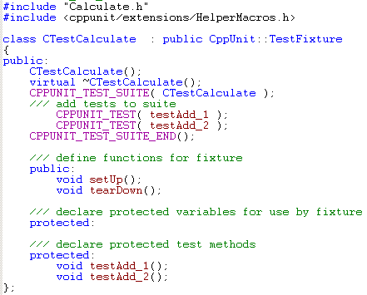
Create CppUnit's MFCTestRunner
Step 1: Create a new dialog-based MFC application (or doc-view one)
Step 2: Setup UnitTest environment for VC6 (see above)
Step 3: Create new test class to do unit test for other class as below picture
Include class need test and HelperMacros
Use macros of TestSuite to test for 2 function:
testAdd_1
testAdd_2
CTestCalculate must inherit from CppUnit::TestFixture

Slide 20
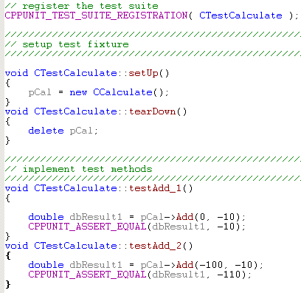


Using CppUnit's MFCTestRunner (Cont)
Register the test suite
CPPUNIT_TEST_SUITE_REGISTRATION
Setup test fixture
setUp
tearDown
Implement test methods
testAdd_1
testAdd_2
Declare & Run MFC TestRunner, copy below code to CMainApp::InitInstance() function:

Slide 21
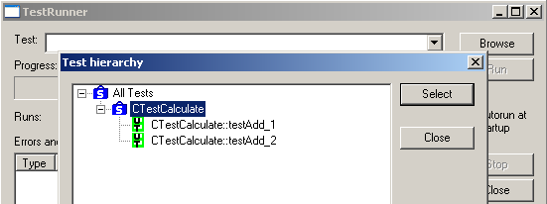
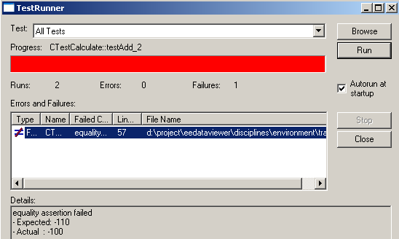
Using CppUnit's MFCTestRunner (Cont)

Slide 22





Build UnitTest for existing MFC project
Add new UnitTest project into workspace of existing MFC project
Setup environment:
Include resource.h from MFC project to UnitTest project
Create new UnitTest class to test a class in MFC project
Note:
Must link tested class in MFC project to UnitTest project
To run UnitTest protected or private function, UnitTest class must be friend class of MFC class

Slide 23
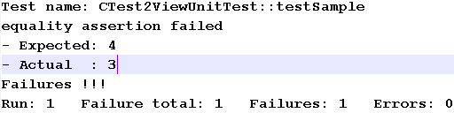
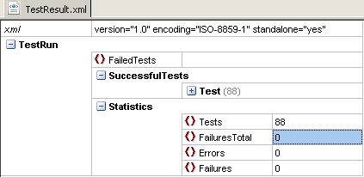
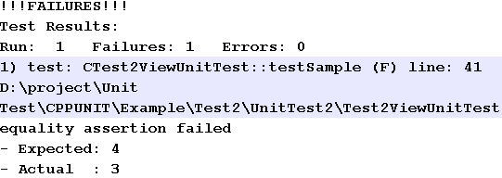
Outputter
There are three types of outputter
CompilerOutputter
CppUnit::CompilerOutputter
XmlOutputter
CppUnit::XmlOutputter
TextOutputter
Use CppUnit::TextOutputter

Slide 24
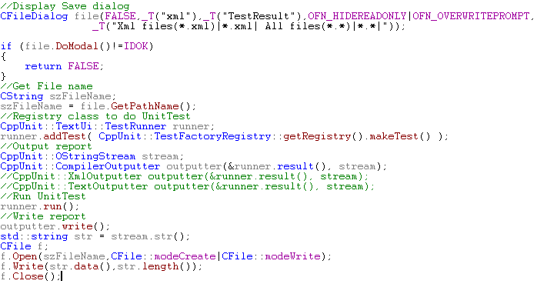
Outputter - Code

Slide 25

Question and Answer

Slide 26
Exercise / Questionnaire

Slide 27
Appendix: Course detail form
Author
Tuan Nguyen Manh
Duration
3 hours
Category
Software Engineering
Type
Theory / Theory and Practice
Examination | Review questions / quiz will be at the end of the course. The purpose is to review the awareness of all attendees on some important points of this course
Intended Audience | Any software technician, engineer, project leader, project manager, manager who are working in software related projects.
Pre-requisites | Those who have basic knowledge of software development life cycle
Completion criteria for the course | Attendee must join at least 80% of course length and finish the review questions section with score rate of 75% or higher.
Criteria for granting training waivers | Those who has experience on CPPUnit, or already attended similar courses

